Slide 1


SIM-CARD REGISTRATION

Slide 2
Prepared By :-
Student Name : Goyani Yash Arvindbhai
Roll No : 156
Enrollment No : 23002170210035
Batch : D-6
Branch : IT

Slide 3
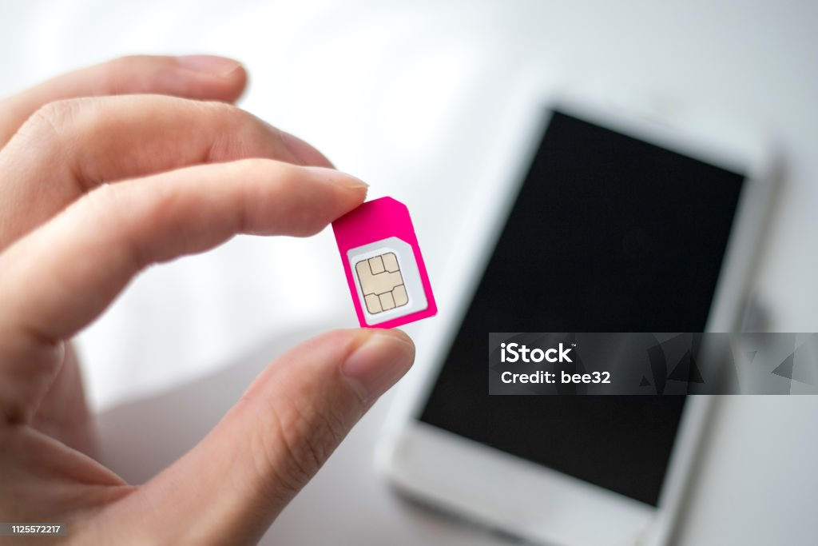
What Is SIM Card?
SIM or Subscriber Identification Module is a smart card that is include in every cell phone of the GSM family of networks.
There are two major types of sim card.
Full Size SIM
Embedded SIM card(For Mobile)
There are two different category of mobile sim.
Prepaid
Postpaid

Slide 4
FLOW CHART
START
REGISTRATION
DISPLAY REGISTRATION FORM
ENTER USER DETAILS

Slide 5
REGISTER WITH ADHAR CARD
REGISTARATION==0
FALSE
TRUE
CHOOSE OPTIONS
INVALID INPUT
TRY AGAIN
TRUE
IF OPTIONS>=0
FALSE
END
START OPERATION
INVALID OPTION
END

Slide 6
Functionality
Registration Process
Personal Information : users provide details such as name , address and identification proof.
User Authentication
Verification Code : users may receive a one-time code via SMS for additional Authentication.
Secure Access : Ensures that only authorized users can activate and use the SIM card.

Slide 7
Thank You

